Slide 1

SQL injection detection and prevention using predictive analytics GitHub link:https://github.com/CSEA14/Final-Review
Batch No: A-14 Project Guide:
D.Alekhya 164G1A0502 Mrs.K.Sudha Kumari,M.Tech.
K.Anitha 164G1A0504 Assistant Professor
V.Ajay Kumar 164G1A0501
Srinivasa Ramanujan Institute of Technology
Department of Computer Science & Engineering

Slide 2
Questions from review-1
What are the existing systems?
What is the problem flow of your project?
What is the difference between analytics and analysis?

Slide 3
Questions from review-2
What is the input and what is the output of the project?
How you do the attack?

Slide 4
Abstract
Structured Query Language Injection Attack (SQLIA) remains an intruder’s exploit of choice on vulnerable web applications to pilfer confidential data from the database with potentially damaging consequences.
Here a trained classifier to be deployed as a web service that is consumed in a application implementing a web proxy Application Programming Interface (API) to intercept and accurately predict SQLIA in web requests.
Thereby preventing malicious web requests from reaching the protected back-end database.

Slide 5
Problem Definition
While transferring data from cloud hosted web applications to IoT smart devices Intruder have an advantage of attacking web applications to steal the data from the database in the form Structured Query Language Injection Attack.
Which can cause serious repercussions especially on transactions.
For this problem we are using predictive analytics to detect and prevent SQLIA.

Slide 6
Existing system
Existing systems are static analysis technique which validate the user input type in order to reduce the chances of SQL injection attacks.
AMNESIA, in this approach the application code itself contains information to produce all the possible SQL queries that could be generated by the application.
But this AMNESIA tool has its own set of drawbacks, biggest one being that it is not a hundred percent accurate and could generate a lot of false positives.

Slide 7
Proposed system
Proposed system provide a representative data set that train a supervised learning model implementing Support Vector Machine (SVM) algorithm.
This can accurately predicts SQLIA thereby preventing malicious web requests from reaching the target back-end database.

Slide 8
Planning
SNO | TASK | DATE
1 | Software installations and front-end development | 18-02-2020
2 | Admin module | 6-03-2020
3 | User module | 20-03-2020
4 | Project execution and submission | 24-03-2020

Slide 9
Literature survey
W. G. J. Hal fond, A. Orso, D. A. Kindy, and A. S. K. Pathan,“AMNESIA: Analysis and Monitoring for NEutralizing SQL-injection Attacks,” Int. J. Commun. Networks Inf. Secure., vol. 5,pp. 80–92, 2013.
SQL injection, a class of code injection attacks in which specially crafted input strings result in illegal queries to a database, has become one of the most serious threats to web applications.
In this paper we present and evaluate a new technique for detecting and preventing SQL injection attacks called AMNESIA.

Slide 10
“SQL Injection Prevention System” 2016 International Conference "Radio Electronics & Info Communications" (UkrMiCo) September 11-16, 2016, Kiev, Ukraine
Existing vulnerabilities of Web system threaten the regular work of information systems. The most common Web system vulnerability is SQL injection.
There is known approaches to protect Web applications against SQL injection attacks.
We use the software to detect this SQL injection attack.

Slide 11
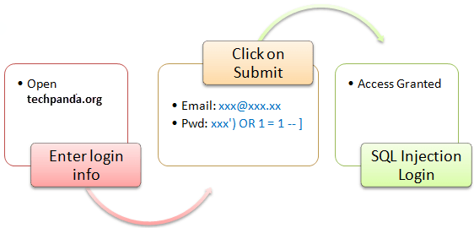
SQL Injection attack

Slide 12
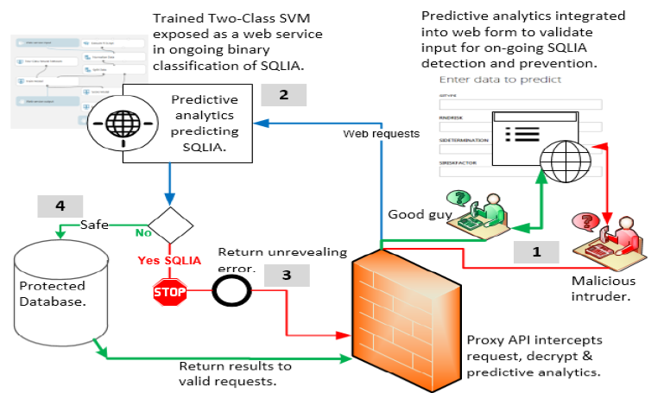
Architecture

Slide 13
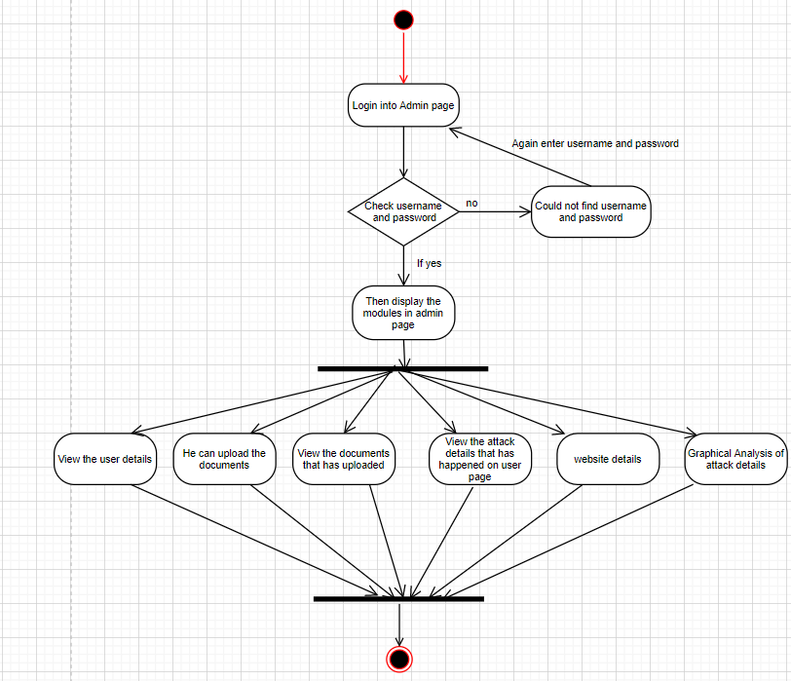
Design
Admin
Activity Diagram for Admin module

Slide 14
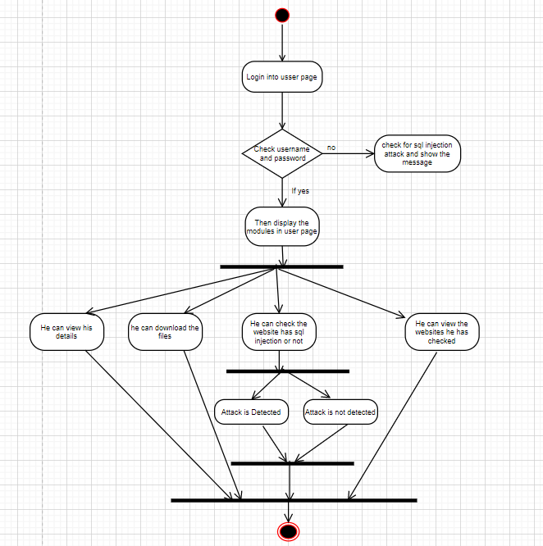
User
Activity Diagram for User module

Slide 15
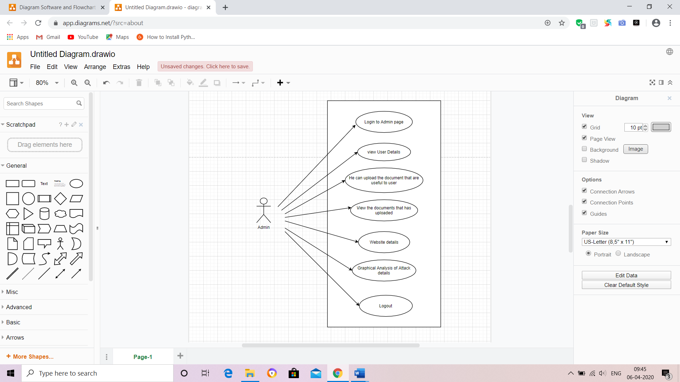
Admin
Use Case Diagram for Admin module

Slide 16
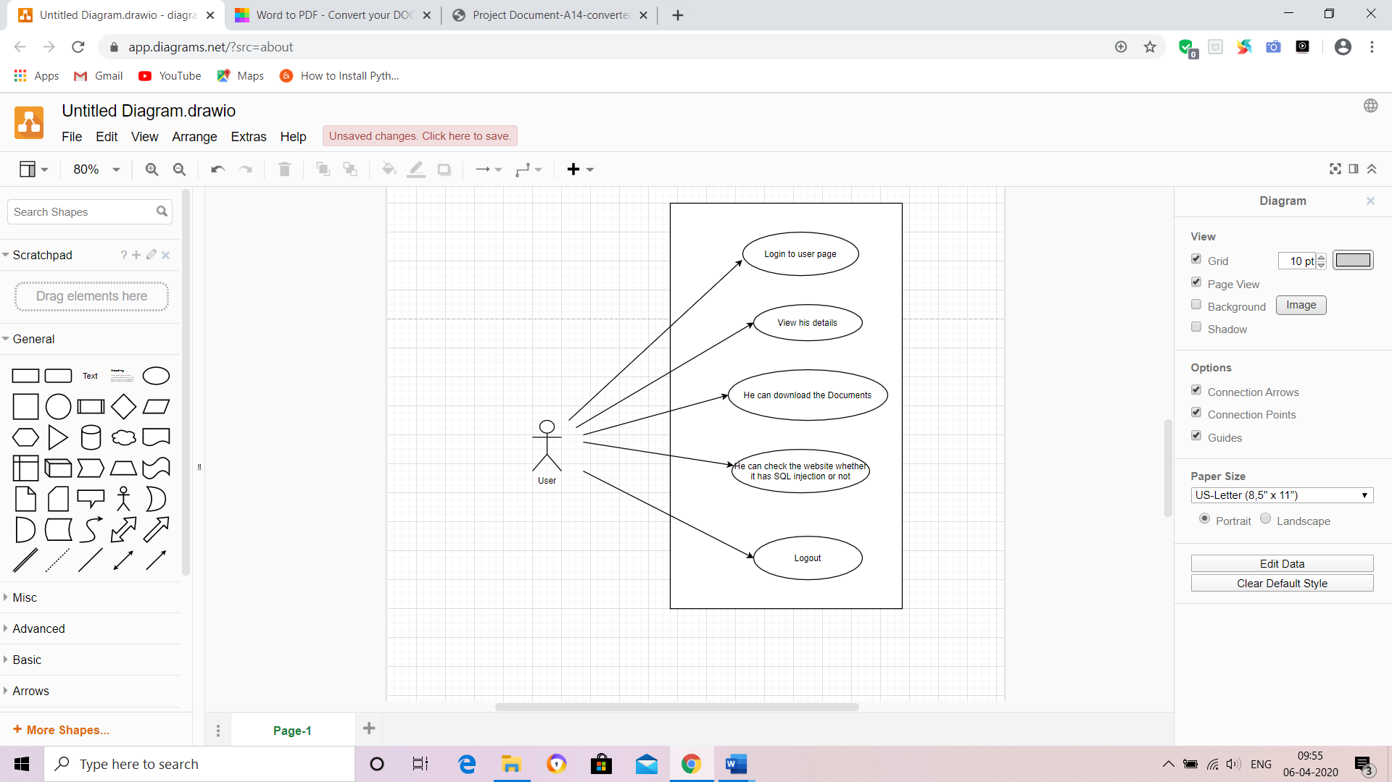
User
Use Case Diagram for User module

Slide 17
Implementation
Admin
User Details
Upload Document
View Document
Attack Details
Graphical analysis

Slide 18
User
File View
File Download

Slide 19
Execution and Results
To run project type following command
“python manage.py runserver”

Slide 20
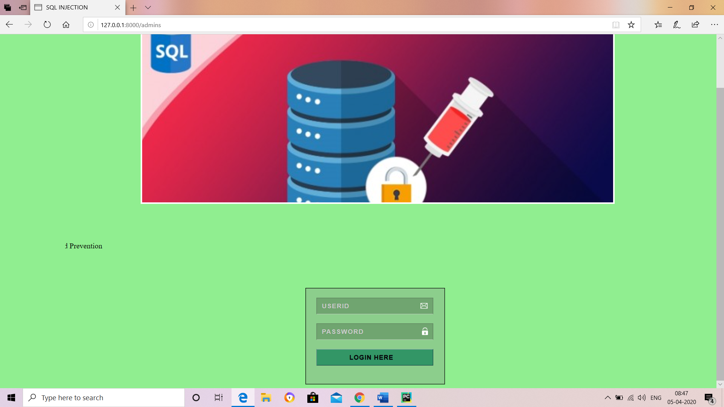
Results
Admin module

Slide 21
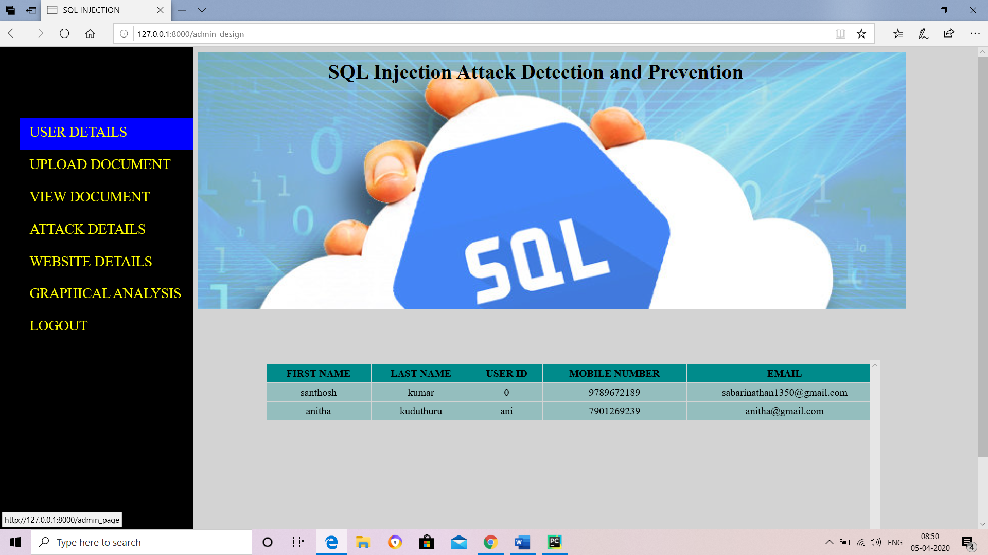

Slide 22
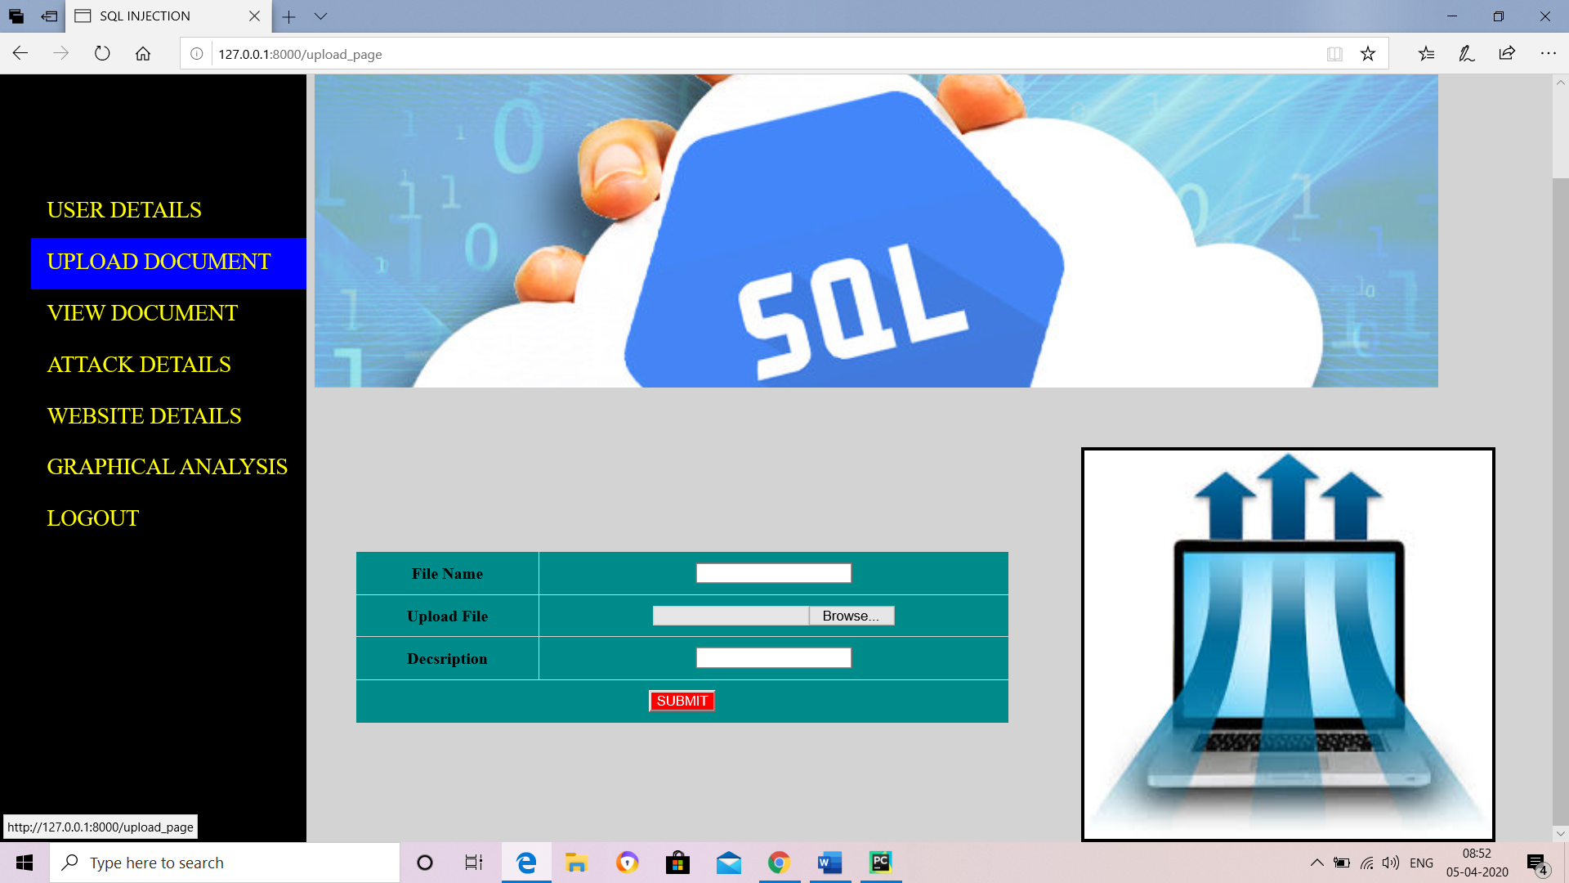

Slide 23
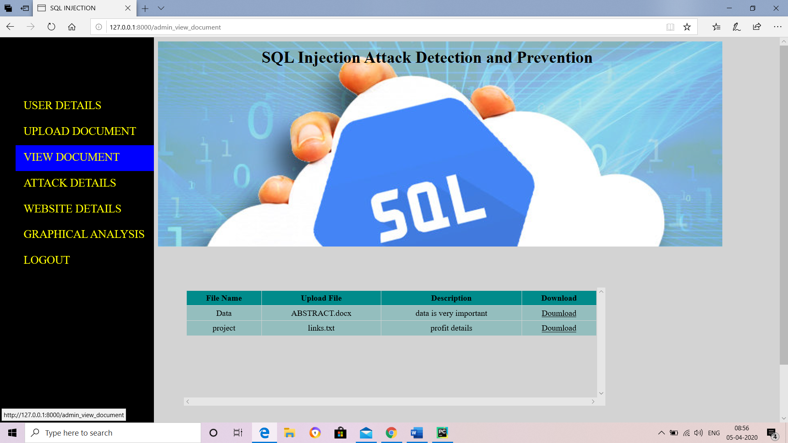

Slide 24
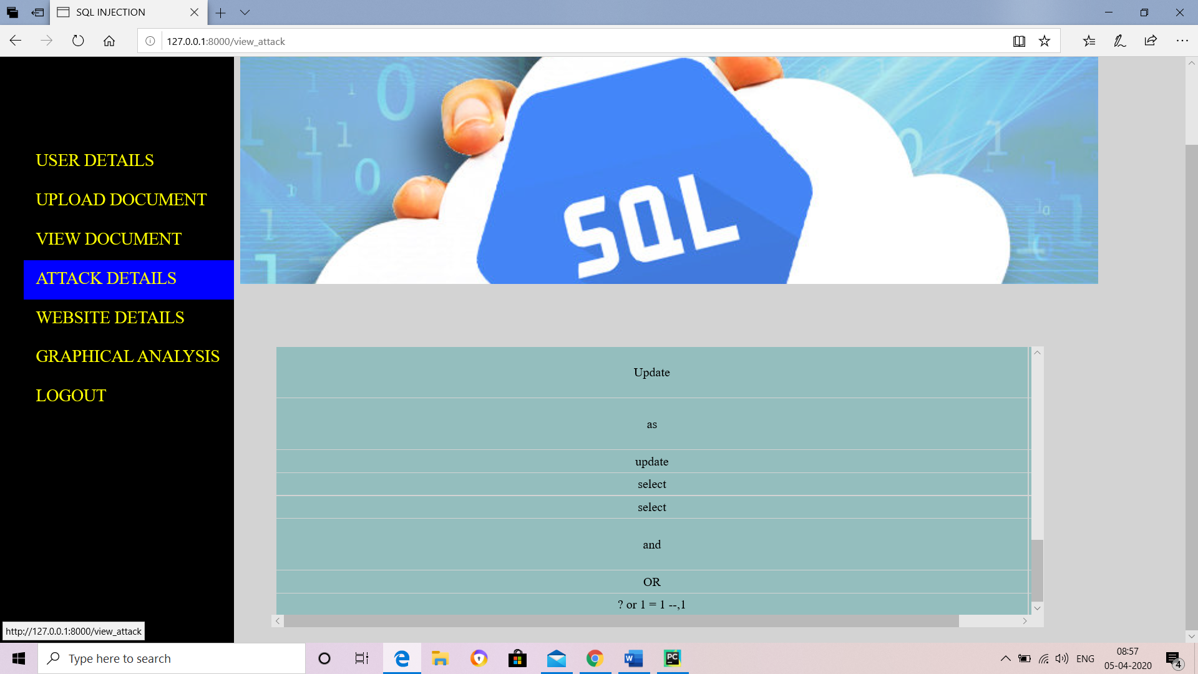

Slide 25
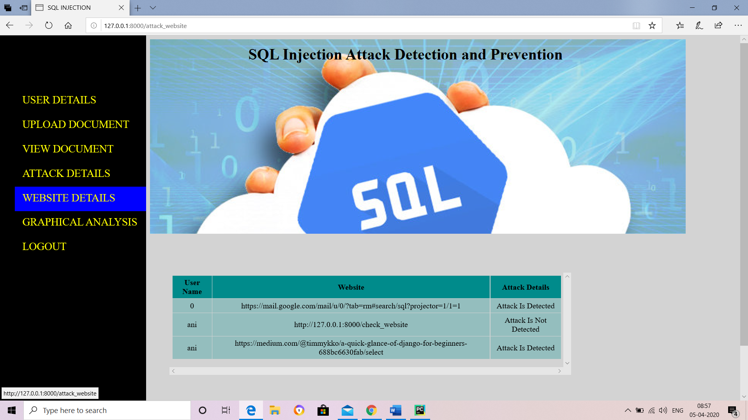

Slide 26
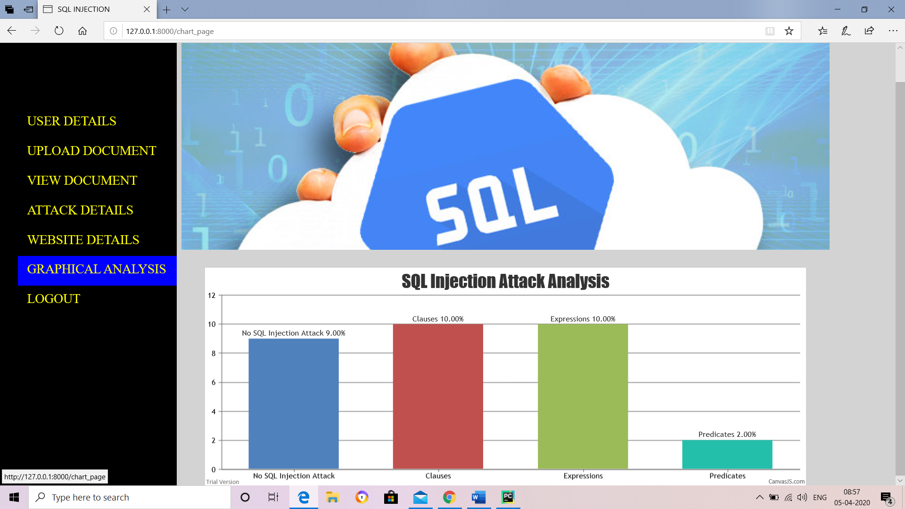

Slide 27
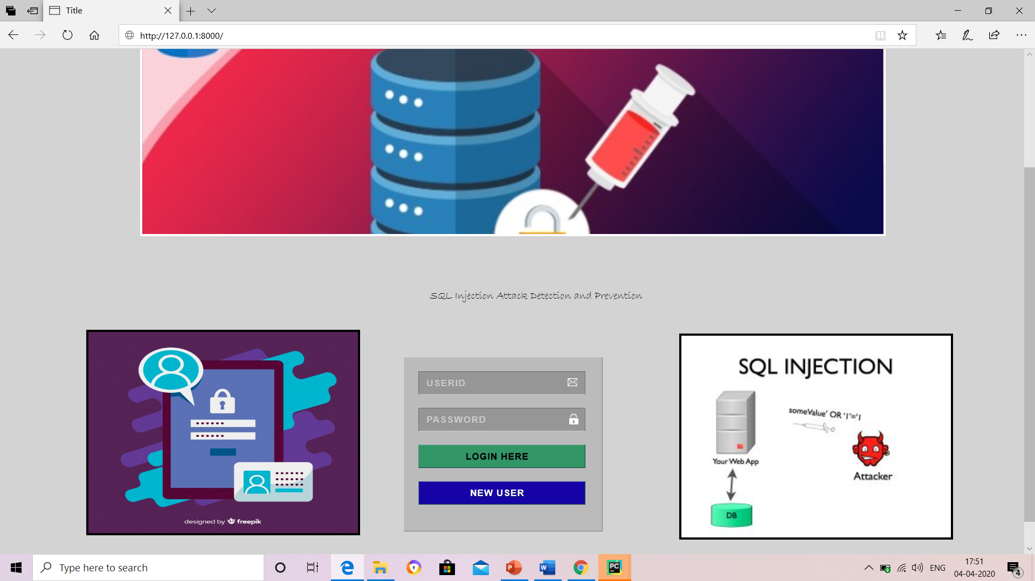
User

Slide 28
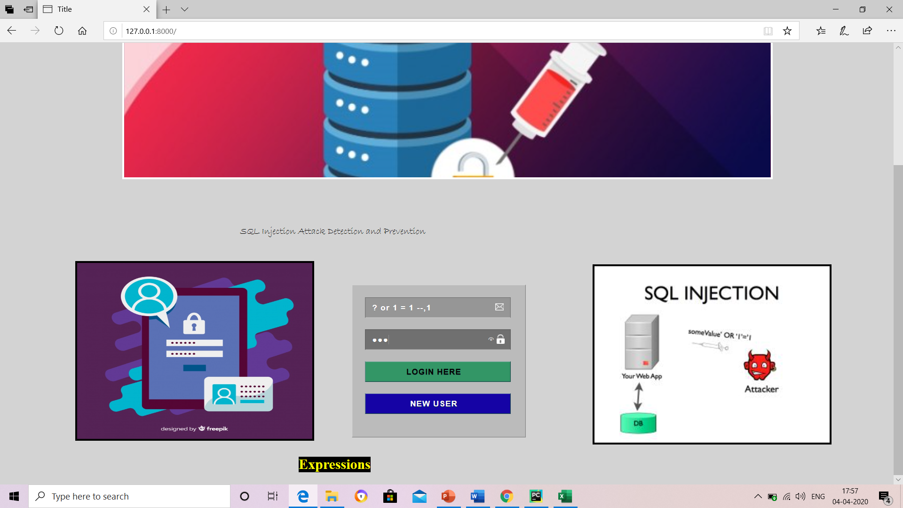

Slide 29
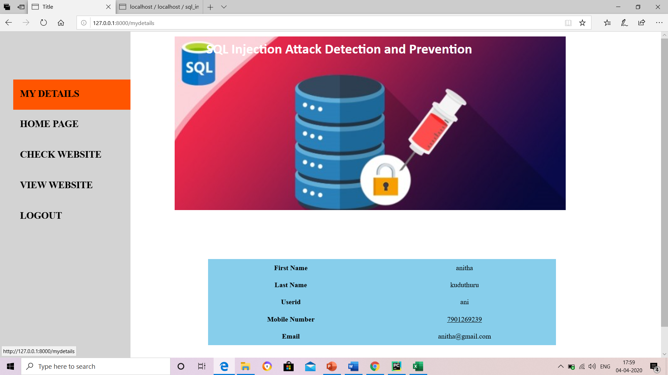

Slide 30
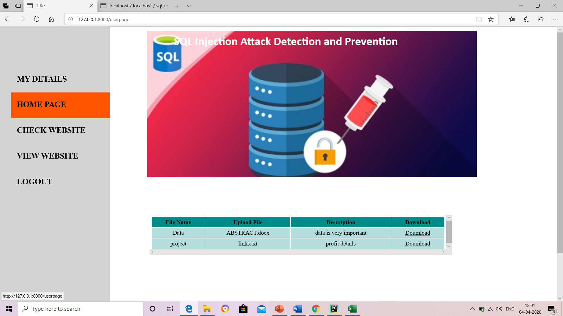

Slide 31
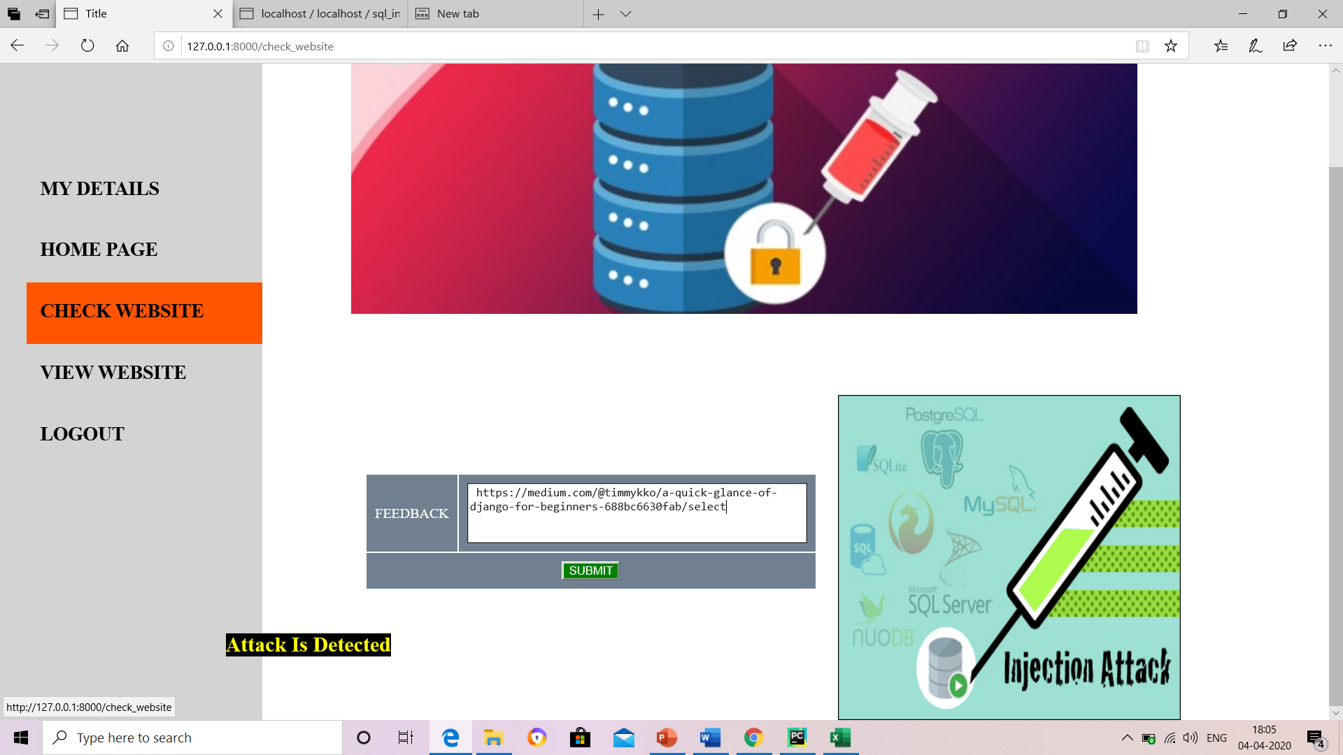

Slide 32
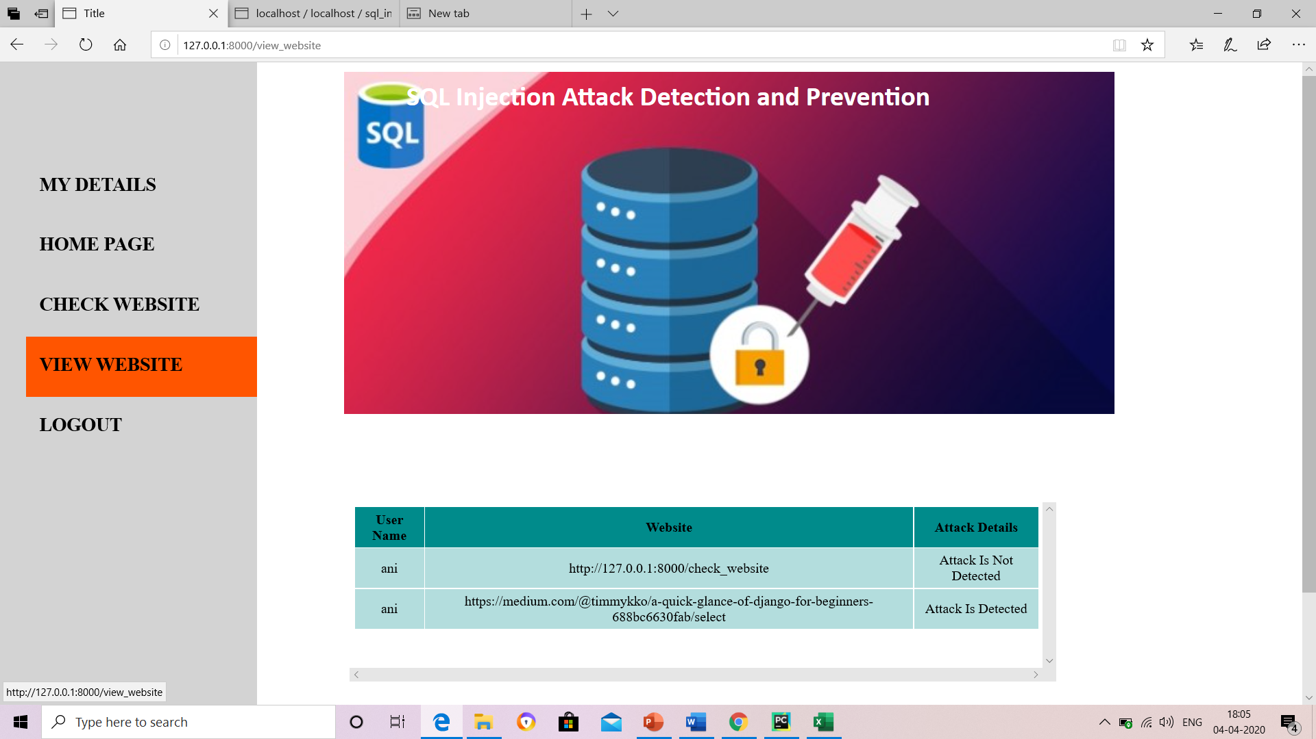

Slide 33
Requirements
Hardware Requirements:
Processor : Intel Core i3
Operating System : Windows 7 or above
Software Requirements:
Back-end : Python
Front-end : HTML, CSS
Database : MySQL

Slide 34
Conclusion
SQL injection attack is a very serious problem of web applications. Finding the efficient solution of this problem is essential. Researchers have developed many techniques to detect and prevent this vulnerability. There is no appropriate solution that can prevent all types of SQL injection attacks.
So we demonstrated in this paper applied predictive analytics to SQLIA detection and prevention in big data context with an excellent result.
In benchmarking this paper against existing works, the methodology proposed here is functional in a big data context which is lacking in existing works before now on SQLIA to our knowledge. Future work involves employing multi-class classifier to identify and group the different SQLIA types as they are predicted.

Slide 35
References
https://viterbi-web.usc.edu/~halfond/papers/halfond05ase.pdf
https://www.researchgate.net/publication/310454603_SQL_injection_prevention_system

Slide 36
THANK YOU
Queries
?

